Slide 1
Web Development
Introduction

Slide 2
What is Web development?
Web development refers to the process of creating , building and maintaining websites and web applications that are accessible through the internet.
It includes :-
Web design
Front-end development
Back-end development
Database management

Slide 3
There are computer languages which are used to implement web development. These are ;
-HTML
-CSS
-Javascript

Slide 4
HTML
Hypertext Markup Language

Slide 5
HTML
HTML (Hypertext Markup Language) is the markup language used to structure the content and layout of web pages.
It provides the basic building blocks of a web page.
It consists of a set of elements(tags) that define various components of a web page. These tags include headings, paragraphs , lists , links , and more.

Slide 6
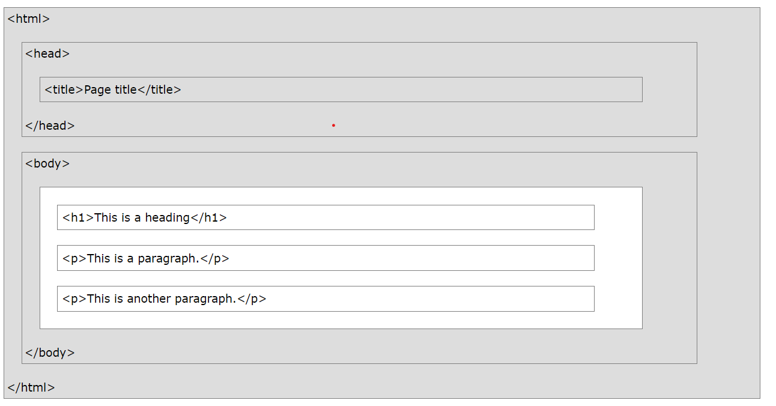
HTML structure

Slide 7
HTML uses a hierarchical structure made up of elements, which are represented by tags.
The <!Doctype> declaration represents the document type and helps the browser to display web pages correctly. It is not case-sensitive.
It must only appear once, at the top of the page .( Before any HTML tags).

Slide 8
The “<html>” element is the root element of an HTML document. It encloses the entire content of the web page. It is divided to main sections i.e “<head>” and “<body>”.
The “<head>” section contains information which is not directly visible to the user. It includes “<title>” , “<meta>”, “<style>”, “<link>” e.t.c
The “<body>” section contains the visible content of the web page including text, images, links and other multimedia elements. It involves “<h1>-<h6>”, “<p>”, “<li>” , “<a>” , “<img>” , “<div>” e.t.c

Slide 9
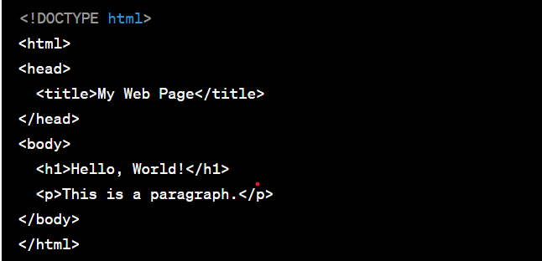
An example of HTML code observing HTML structure can be seen below.

Slide 10
HTML Tags
HTML tags define various parts of a document.
They come in pairs including an opening and a closing tag with the required content included in between. For example, “<p>This is a paragraph.</p>”, “<h1>This is a heading.</h1>” e.t.c
Some tags like “<img>”, “<br/>” , “<hr/>” e.t.c do not have closing tags. They stand individually.
HTML tags define elements within a web page. Each element contributes to the overall structure and layout of the page.
There are many HTML tags which are available for use. Some of them include : “<p></p>” , “<li></li>” , “ <a></a>” , “<div></div>” , “<form></form>”.

Slide 11
HTML attributes
Attributes provide additional information about HTML elements
They are always included in the opening tag and they come in name/value pairs.
For example:
“<a href=“https://www.example.com”>Visit our website.</a>”
In our example, our “<a></a>” (anchor) tag has “href” as it’s attribute with the value of “https://www.example.com”.(href is the attribute’s name.)

Slide 12
HTML Semantic markup
This involves adding meaning to the content instead of just indicating style.
It conveys the purpose of the content.
The latest version of HTML (HTML5) has introduced several semantic tags that provide meaning to the content.
These include “ <header>” , “<nav>” , “<main>” , “<article>” , “ <section>” , “<aside>” and “<footer>”.

Slide 13
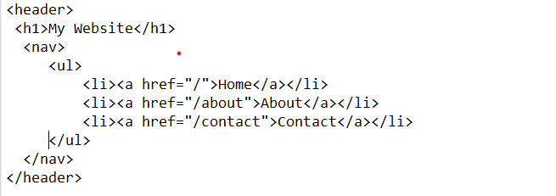
The “<header>” element represents the introductory content of a web page or a section typically containing headings, logos and navigation menus. An example can be observed below.

Slide 14
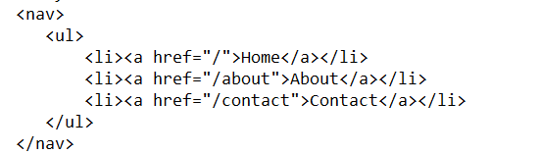
The “<nav>” element is used to define a navigation menu, typically containing links to other parts of yhe website.
Example:

Slide 15
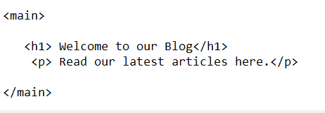
The “<main>” element represents the main content of the web page, excluding headers and footers.
Example:

Slide 16
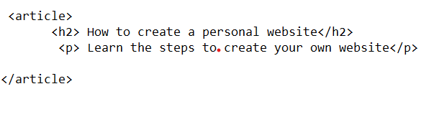
The “<article>” element defines a self-contained , independent piece of content such as a blog post, news article or forum post.

Slide 17
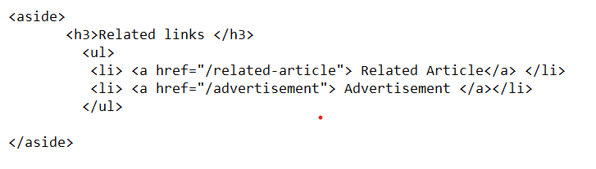
The “<aside>” element represents content that is tangentially related to the content around it such as sidebars , pull quotes or adverisements.
Example:

Slide 18
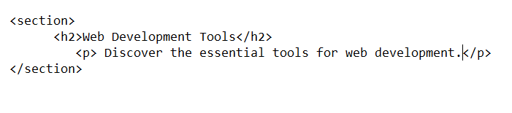
The “<section>” element groups related content within a web page. It helps in organizing content hierarchically.
Example:

Slide 19
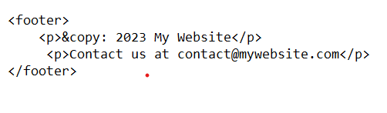
The “<footer>” element contains footer content for a section or the entire page , often including copyright information, contact details, and links.
Example:

Slide 20
CSS
Cascading Style Sheets

Slide 21
CSS
CSS(CascadingStyleSheets) is used for styling and formatting web pages.
It allows web developers to control the appearance of HTML elements by specifying attributes like colors, fonts, spacing and positioning.

Slide 22
Adding CSS to HTML file
There are three ways which can be used to add CSS to a HTML file. These are:-
-Inline styles: this involves adding CSS directly to individual HTML elements using the style attribute. For example,
“<p style=“color: blue;”> This is blue text </p>”.
-Internal stylesheets: they are defined within the document’s “<head>” section using the “<style></style>” element.
-External stylesheets: This is a most common and recommended method for intergrating CSS into HTML.

Slide 23
This involves adding a separate CSS stylesheet file to a HTML document. The “<link>” tag is used in this case.
For example,
“ <link rel=“stylesheet” href=“./example.css”> ”
In this case, “example.css” refers to the file containing the CSS code.

Slide 24
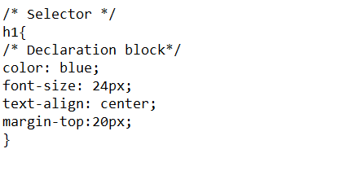
CSS style rule
CSS code involve two parts i.e:
-selectors
-declaration block
“h1” refers to the selector and everything
inside the curly braces“{…}” is the
declaration block.

Slide 25
The selector specifies which HTML element should be styled. From our example above , the “h1” tag was the one that was being styled.
The declaration block is enclosed within curly braces “{…..}” . It contains a list of property-value pairs that define how the selected “h1” elements should be styled. Each property is followed by a colon and it’s value is terminated with a semicolon.
“ style property : value ; “

Slide 26
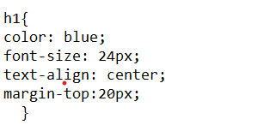
CSS Selectors
The selectors allow you to target specific elements or groups of elements for styling. The selectors can also be more specific i.e instead of tags, IDs , classes , pseudo-elements e.t.c
Examples:
Element selector
This involves using HTML tags like “h1”:

Slide 27

2. Class Selector
This involves using classes .For example, to style all elements with the class “button” to blue:

Slide 28
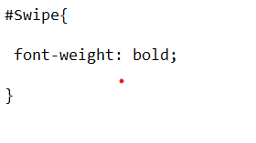
3. ID selector
This involves using ID elements. They mainly target single unique elements. For example, styling element with the ID “Swipe” to bold:

Slide 29
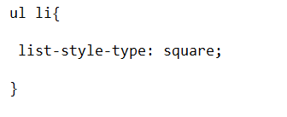
4. Descendant Selector
This selector targets elements that are descendants of a particular element. For example, To style all “<li>” elements within a “<ul>”
Element:

Slide 30
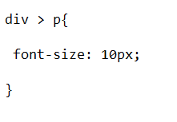
5. Child selector
These selectors target elements that are a direct child of another element. For example, to style only the immediate child “<p>” elements within a “<div>”:

Slide 31
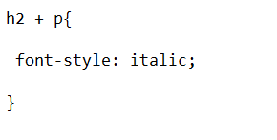
6. Adjacent sibling selector.
It selects an element that is immediately preceded by another specific element. For example, To style an “<h2>” element that is immediately followed by a “<p>”:

Slide 32
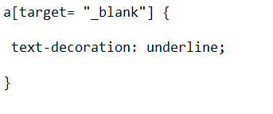
7. Attribute selector.
They target elements with a specific attribute and attribute value.
Example: To style all anchor tags with a “target” attribute:

Slide 33
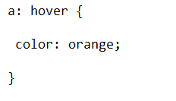
8. Pseudo-Class Selector
They target element s based on their state or position. For example, To style a link when a mouse hovers over it:

Slide 34
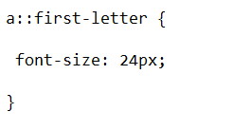
9. Pseudo-Element Selector
Pseudo-elements target specific parts of an element, such as the first letter or first line . For example, to style the first letter of a paragraph:

Slide 35
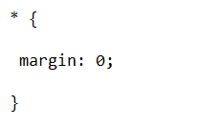
10. Universal Selector
The universal selector targets all elements on a page. For example, To add margin to all elements.

Slide 36
CSS Box model
It describes how elements on a web page are rendered and how their content , padding , border and margin areas interact to determine the element ‘s size and position.
Each element HTML element is considered a box, and the box model provides a structured way to understand the space an element occupies in a document.
The box model is used to provide precise control over the layout and spacing of elements on a web page.

Slide 37
The CSS box model consists of four essential components:
Content: This is the innermost area of the box and contains the actual content like text, images or other HTML elements.
Padding: This is the space between the content and the element’s border. It is used to create spacing and separation between the content and the border. You can specify the padding with CSS properties like “padding-top” , “ padding-right” , “padding-bottom” and “padding-left”.

Slide 38
3. Border: The border surrounds the padding and content , creating a visible boundary for the element . You can set the border’s width, style and color using CSS properties like “border-width” , “border-style” and “border-color”.
4. Margin: This is the space outside the border , which separates the element from other elements on the page. It defines how far an element should be from its neighbouring elements. You can control the margin with CSS properties like “margin-top” , “margin-right” , “margin-bottom” and “margin-left”.

Slide 39
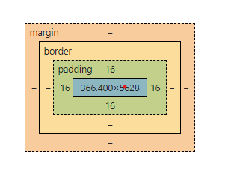

Slide 40
CSS Flexbox and grid
These are layout models that make it easier to design complex layouts.
The flexbox layout is designed for creating one-dimensional layouts, typically for arranging items in a row or column.
It is useful for building flexible and responsive designs.

Slide 41
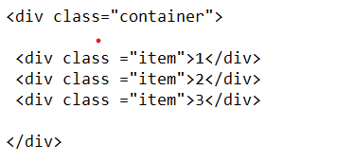
It is great for distributing space and aligning items along this single axis.
For example,
-The HTML structure,

Slide 42
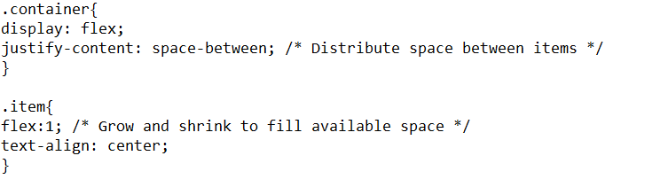
-CSS code using flexbox,
In the example, the items are arranged horizontally with space between them.

Slide 43
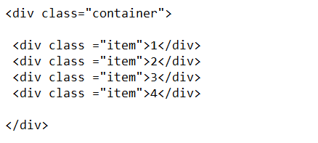
CSS Grid layout is a two-dimensional system that lets you create grid structures for layouts.
It is perfect for creating complex grid-based designs i.e structures with rows and columns.
For example,
-The HTML structure,

Slide 44
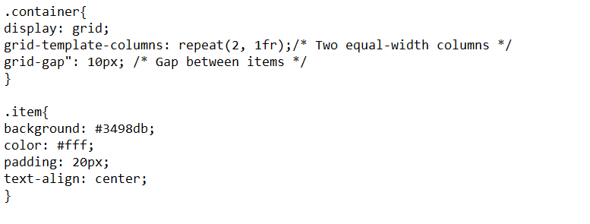
-CSS using Grid Layout,
In this example, the items are arranged in a 2X2 grid with equal-width columns and a 10px gap between them.

Slide 45
Javascript

Slide 46
What is Javascript?
Javascript refers to a programming language that allows a person to add interactivity and dynamic behavior to websites.
Javascript is a versatile and widely used programming language which is used for web development.

Slide 47
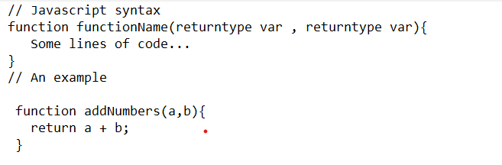
Javascript sysntax
Javascript uses a C-style syntax with curly braces and semicolons. An example can be observed below.

Slide 48
Connecting Javascript file to HTML
Direct method: Javascript code can be written directly in the html file by using the “<script></script>” tag. The javascript code is written within the tags.
External method: Another way involves linking an external file containing javascript code(.js file) to the HTML document by using the following annotation:
‘<script src=“example.js”></script>’

Slide 49
NOTE: It is more effective to place the “<script></script>” right before the closing body tag “</body>”. This will make the javascript code to run after each component of the HTML document has loaded thus preventing unnecessary bugs and making it more effective.

Slide 50
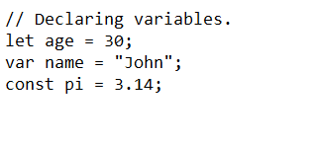
Variables and data types
Javascript supports various data types including numbers, strings and objects. New variables can be declared using “var” , “let” or “const”.
“let” and “var” (“let” is mostly preferred over “var”)are used to declare variables of different data types that can be assigned new values without any need of re-declaring the variables.
“const” is used to declare variables that can not be re-assigned with new values.
For example,

Slide 51
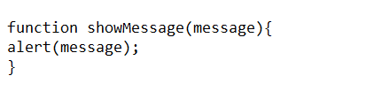
Javascript functions
They are a fundamental part of javascript.
They allow you to encapsulate reusable code.
An example of a function can be observed below.

Slide 52
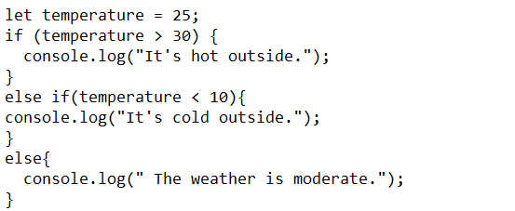
Javascript conditional statements
Javascript supports “if” , “else if” and “else” statements for making decisions in your code. For example:

Slide 53
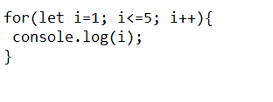
Javascript loops
You can use loops like “for” and “while” for repetitive tasks.
Here is an example of a “for” loop that counts from 1 to 5:

Slide 54

Javascript DOM Manipulation
Javascript can manipulate the Document Object Mode(DOM) to change the content and structure of web pages. For instance, to change the text of an HTML element with an id of “myElement”, you can do:

Slide 55
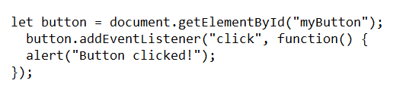
Javascript Event Handling
Javascript enables you to respond to user actions like clicks and keypresses. Below is an example of an event handler for a button click.

Slide 56
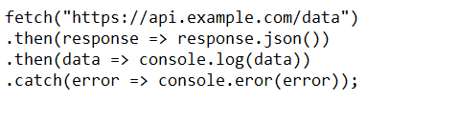
Javascript asynchronous programming
Javascript support s non-blocking and asynchronous operations using callbacks , promises and async(await). For example, making an asynchronous HTTP request with the “fetch”API:

Slide 57
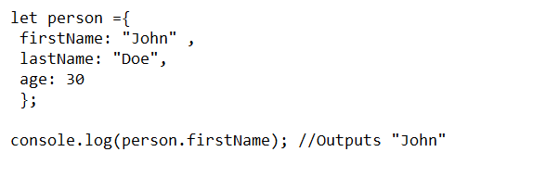
Javascript Object and object-Oriented Programming(OOP)
Since javascript is an object-based language, and you can create and manipulate objects. Here is an example of creating an object and accessing its properties:

Slide 58
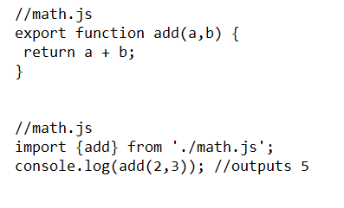
Javascript Modules
Javascript supports module-based code organization, allowing you to separate your code into reusable and maintainable modules. For instance:

Slide 59
THE END

Slide 60
Name: Lorrvin.K.Longinus
Reg no: 2102209213992
Class: OD21-IT

